Slide 1




Introduction to Machine Learning Decision Making
Dr Mengyan Zhang
NCI, Australia
University of Oxford

Slide 2

What we will cover
Applications
Bandits
Active Learning

Slide 3
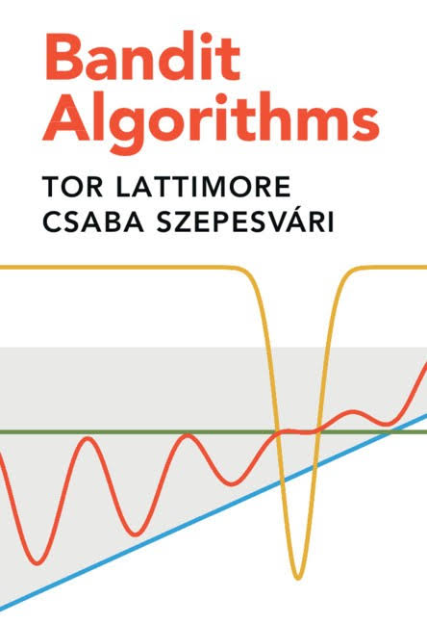

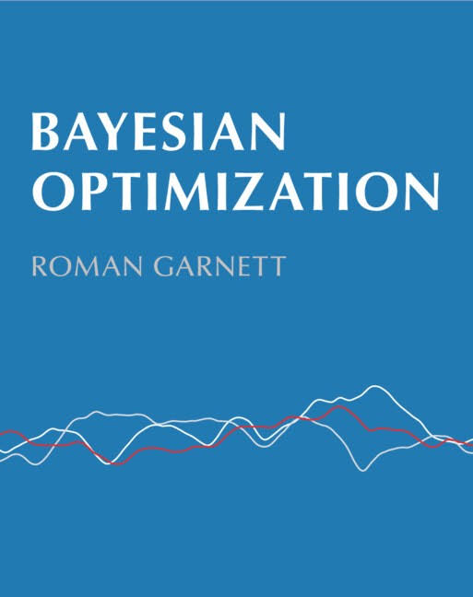
Textbook (if you’d like to learn more)

Slide 4
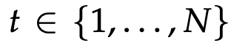
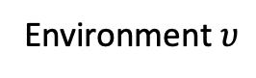
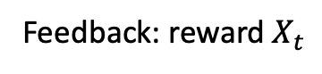
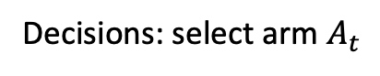
Sequential decision-making: Bandits
Goals:
Regret minimisation
Best arm identification
(Bayesian) Optimisation
Stochastic Bandits
Decisions: select arm $A_{t}$
Environment $υ$
Agent
Arms
…
Reward
distributions
…
Feedback: reward $X_{t}$

Slide 5
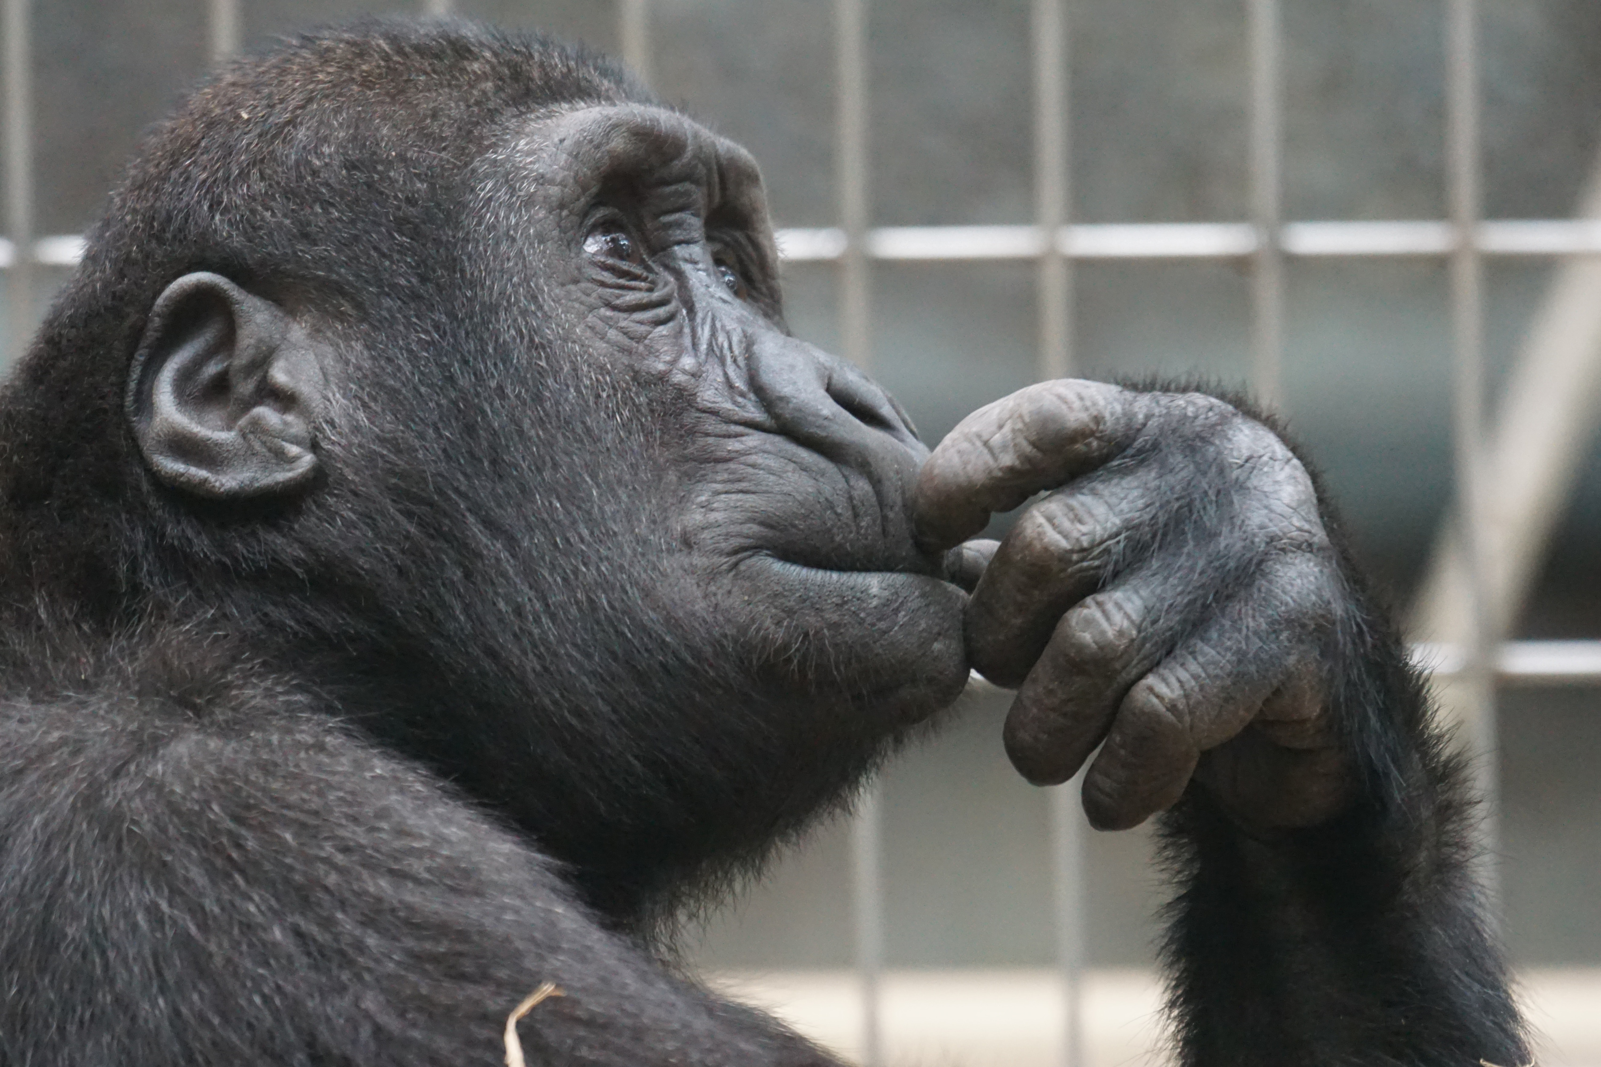
Exploitation vs. Exploration ?
Other possibilities
have not been tried or
with high uncertainty
Best choice with
the current information
How to allocate samples adaptively ?
Notes:
MAB problems illustrate an exploration-exploitation tradeoff dilemma where agents try to optimise their
choice in face of uncertainty. They need to decide between exploitation in terms of the best choice with the current information, or exploration in terms of some other possibilities which have not been tried but have a chance to beat the current best options

Slide 6
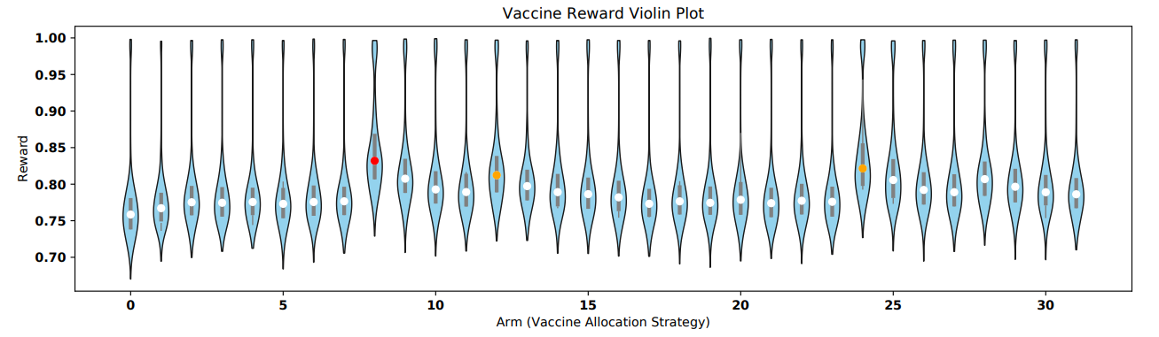
Applications: Vaccine testing
Identify optimal strategies (highest mean/median reward) for allocation vaccines
Arm: vaccine allocation strategy
Reward: proportion of individuals that did not experience symptomatic infection
Zhang, M. ; Ong, C.S.. Quantile Bandits for Best Arms Identification. ICML2021.

Slide 7
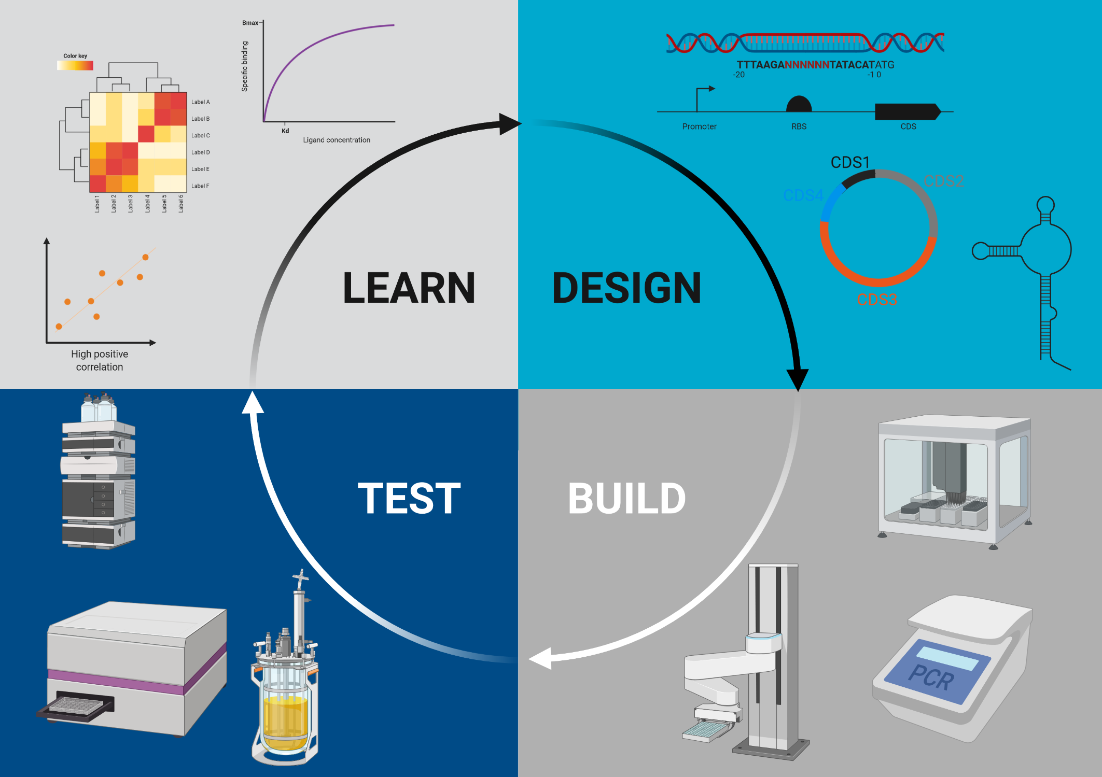

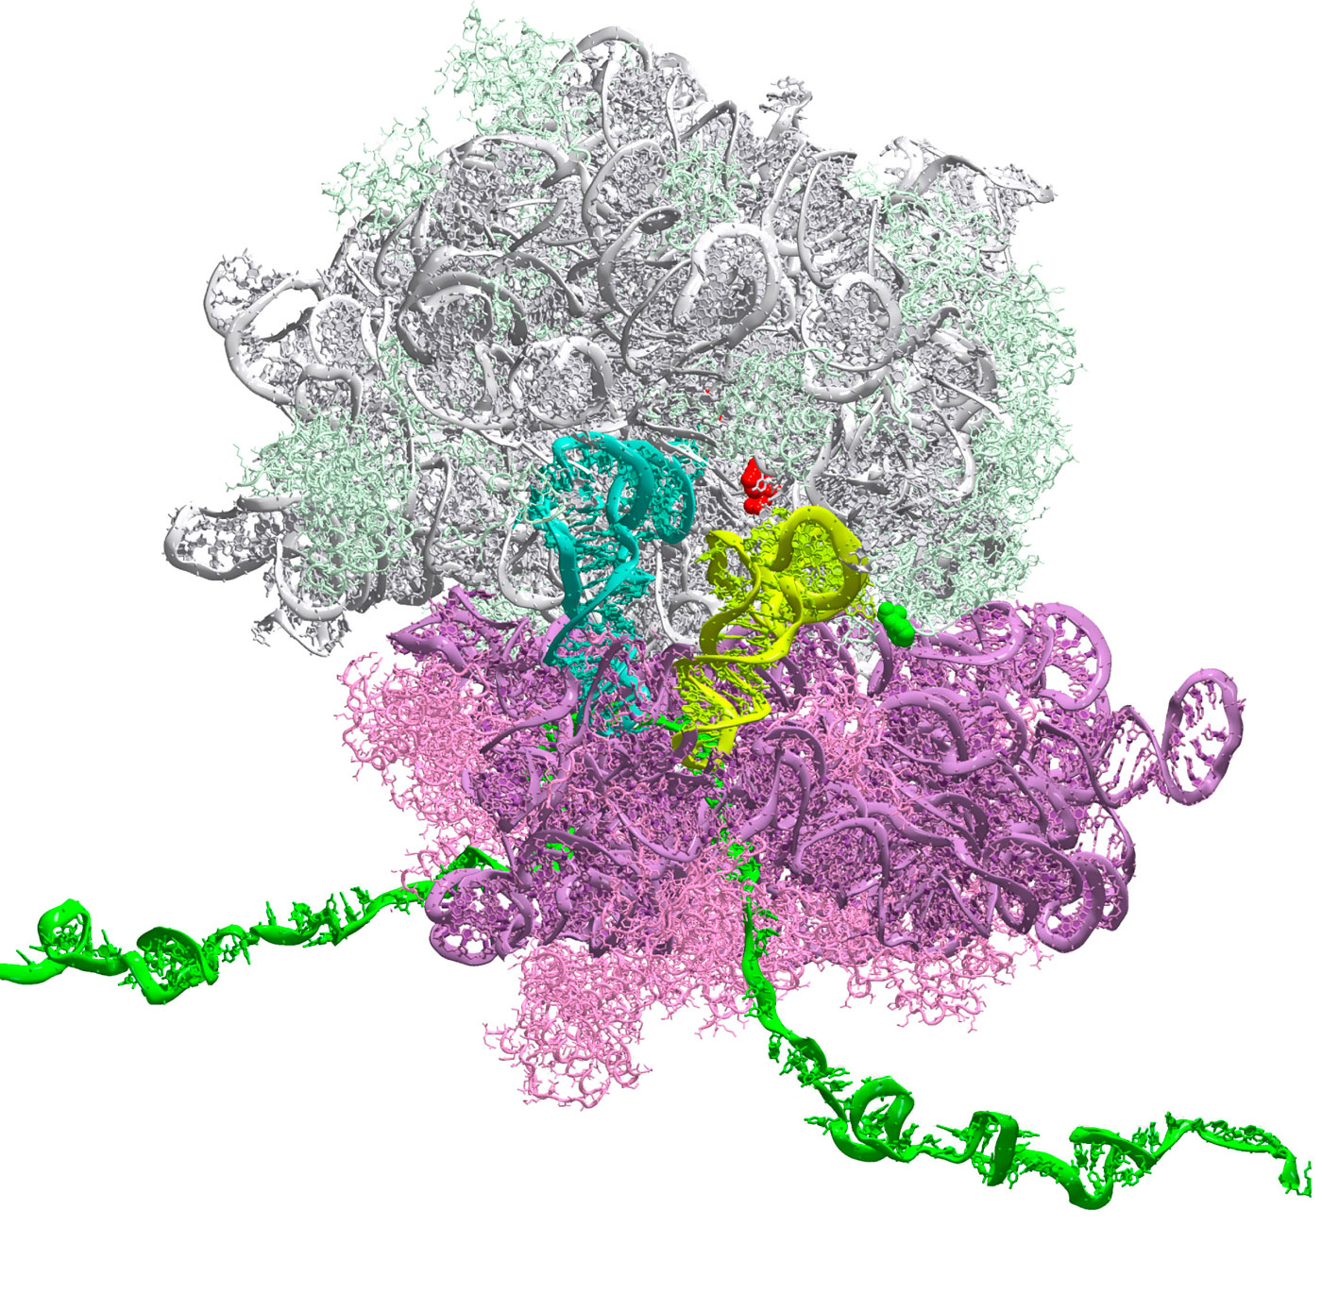
Applications: Biological design
With fixed budget, design Ribosome Binding Site (RBS) sequences
Optimize the protein expression level
Identify the DNA sequences with highest possible protein expression level
Arm: RBS sequence | Reward: Normalized* Protein Expression Level
TTTAAGAGTTATATATACAT | 1.58
TTTAAGAATATGCTATACAT | 1.42
TTTAAGACTCGGATATACAT | 0.14
TTTAAGAGTTTTTTATACAT | 2.88
* zero mean and unit variance normalization $z=\frac{x−μ}{σ}$
Machine learning guided batched design of a bacterial Ribosome Binding Site. Mengyan Zhang, Maciej Bartosz Holowko, Huw Hayman Zumpe, Cheng Soon Ong. ACS Synthetic Biology Journal 2022..

Slide 8

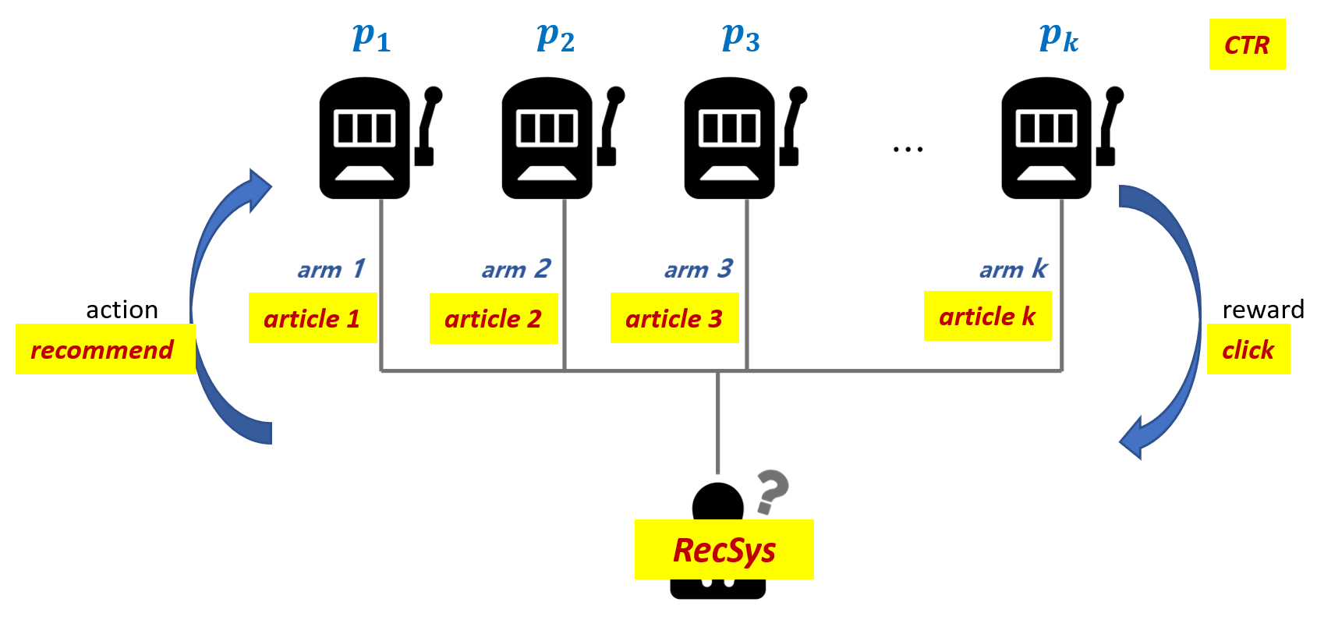
Applications: Recommendation System
BAI: identify the most popular items (with potential high CTR) above some level of confidence using fewest possible samples/ with fixed budget
Regret minimization: recommend items sequentially to users with the goal of minimize cumulative regret
Arm: item (e.g. news)
Reward: click/ preference
Nan Li, Peng Hu, Wenming Xiao, Liangjie Zhang Exploration & Exploitation in Recommender System 2021 Slides

Slide 9

Application: Clinical Treatment Recommendations
Help clinicians to recommend treatments for patients
Arms: treatments
Rewards: the health condition of patients
Picture from https://hms.harvard.edu/news/more-intelligent-medicine

Slide 10
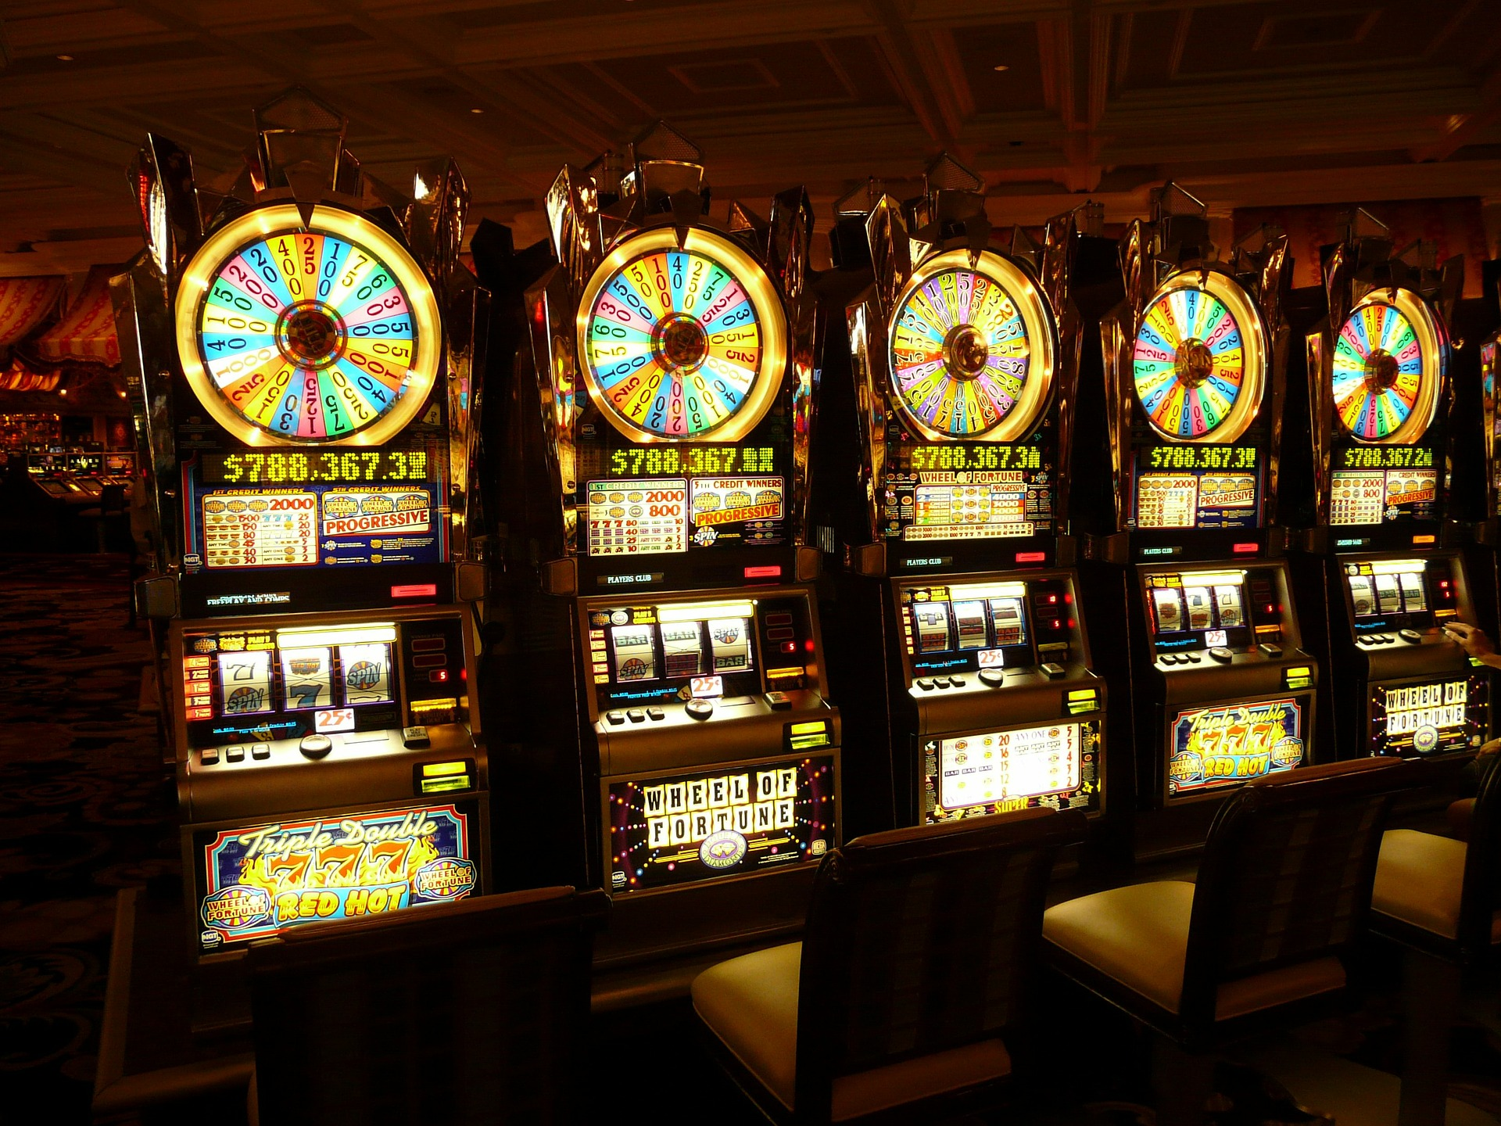
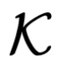
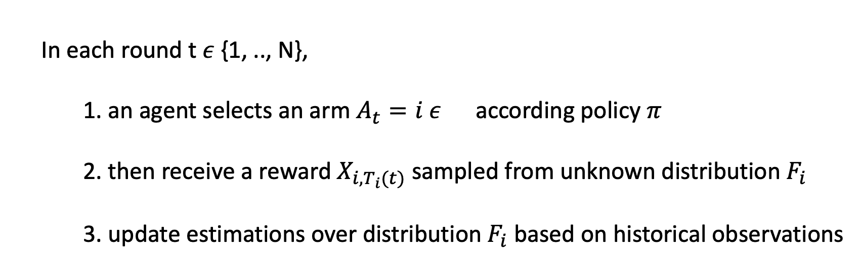
Multi-armed Bandits:
Sequential decision-making
In each round t $ε$ {1, .., N},
1. an agent selects an arm $A_{t}=i ε$ according policy $π$
2. then receive a reward $X_{i, T_{i}(t)}$ sampled from unknown distribution $F_{i}$
3. update estimations over distribution $F_{i}$ based on historical observations
Notes:
Multi-Armed Bandit (MAB) are sequential experiment design problems where an agent adaptively
chooses one option among several actions to maximise cumulative rewards.
More precisely, in each round t, …
Samples are independent.

Slide 11
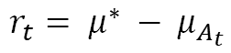
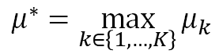
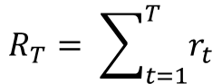
Multi-Armed Bandits
Simple regret
$$r_{t}= μ^{∗} − μ_{A_{t}}$$
where
$$μ^{∗}=\max_{k∈\left\{1, …, K\right\}}{μ_{k}}$$
Best Arm Identification
Fixed Budget:
the number of round for exploration phase is fixed and known
to recommend best arm(s)
at the end of exploration stage
Fixed Confidence:
the confidence level of quality of returned arms is fixed
Regret minimization: maximize the cumulative reward
(i.e. minimize cumulative regret)
Cumulative regret
$$R_{T}= \sum_{t=1}^{T}{r_{t}}$$
Notes:
In terms of the objective function, the MAB problems can be divided into two groups: regret minimisation problems, where the goal is usually to maximise the cumulative rewards, i.e. minimise the cumulative regret;
{Best Arm Identification} (BAI) problems, where the goal is to select the optimal arm (or potentially $m$ best arms) after the exploration stage with fixed budget or fixed confidence.
In terms of the summary statistics, the majority of previous work consider the optimal arms as the arm with maximum population mean.
Recent work shows interesting considerations in terms of qualify arm wrt the risk-averse measure, for example, ….
We consider the quantile based bandit problems, we will show the motivation of using quantiles in toy examples.

Slide 12
Why Bandits?
Challenge: sequential decision-making with uncertainty
Provide model for E & E dilemma
Applications:
Adaptive experimental design: clinical, drug, food
Configure web interfaces: item recommendations, dynamic pricing, ad placement
Plays a role in algorithms like Monte Carlo Tree Search
Rich structure connecting to other branches of math: concentration analysis, information theory, etc.
Tor Lattimore and Csaba Szepesvari, 2020. Bandit Algorithms. Cambridge University Press.

Slide 13
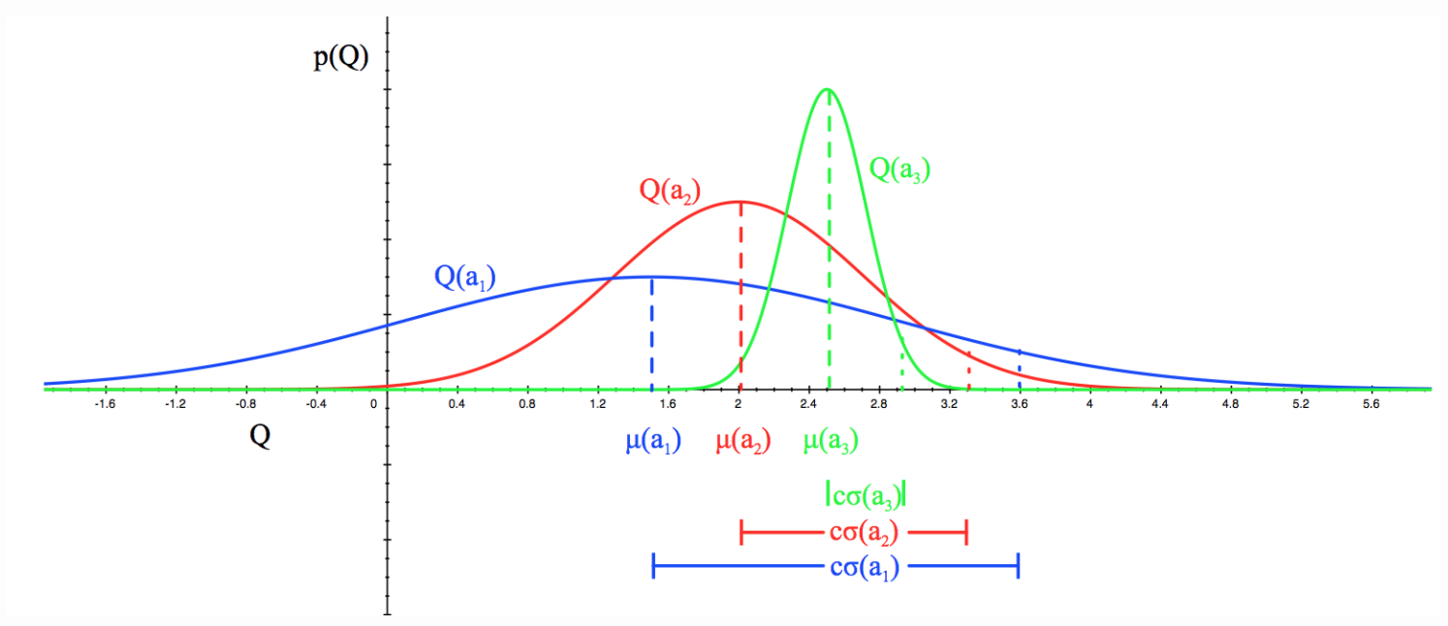
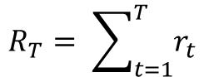
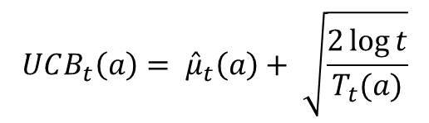
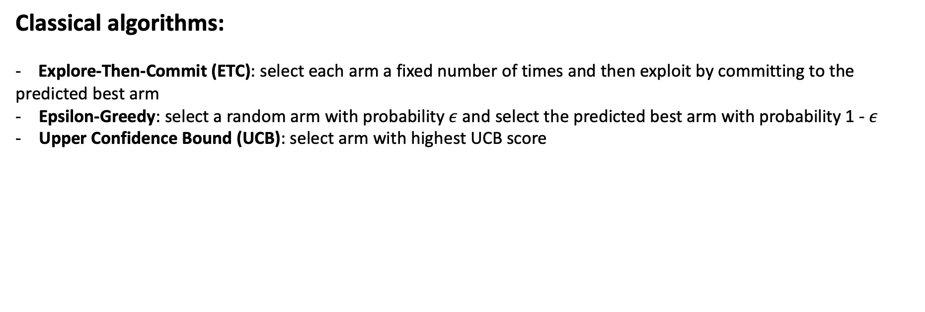
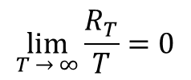
MAB Regret minimization: maximize the cumulative reward
(i.e. minimize cumulative regret)
$$R_{T}= \sum_{t=1}^{T}{r_{t}}$$
Cumulative regret
$$\lim_{T → ∞}{\frac{R_{T}}{T}=0}$$
A good policy should have sublinear cumulative regret
Classical algorithms:
- Explore-Then-Commit (ETC): select each arm a fixed number of times and then exploit by committing to the predicted best arm
Epsilon-Greedy: select a random arm with probability $ε$ and select the predicted best arm with probability 1 - $ε$
Upper Confidence Bound (UCB): select arm with highest UCB score
$${UCB_{t}\left(a\right)= \hat{μ}}_{t}\left(a\right)+ \sqrt{\frac{2\log{t}}{T_{t}(a)}}$$
image source: UCL RL course lecture 9’s slides)
Notes:
In terms of the objective function, the MAB problems can be divided into two groups: regret minimisation problems, where the goal is usually to maximise the cumulative rewards, i.e. minimise the cumulative regret;
{Best Arm Identification} (BAI) problems, where the goal is to select the optimal arm (or potentially $m$ best arms) after the exploration stage with fixed budget or fixed confidence.
In terms of the summary statistics, the majority of previous work consider the optimal arms as the arm with maximum population mean.
Recent work shows interesting considerations in terms of qualify arm wrt the risk-averse measure, for example, ….
We consider the quantile based bandit problems, we will show the motivation of using quantiles in toy examples.

Slide 14
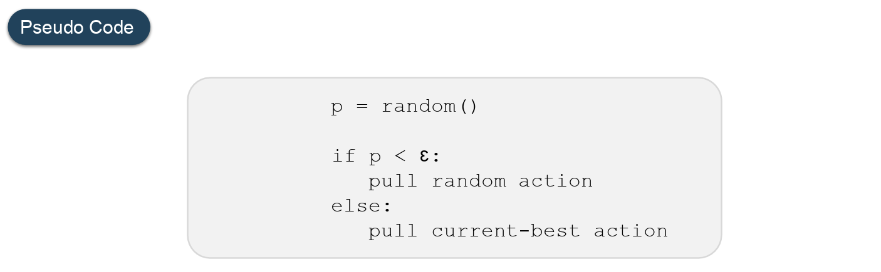
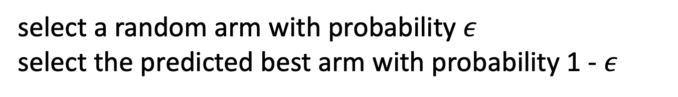
Epsilon-Greedy
select a random arm with probability $ε$
select the predicted best arm with probability 1 - $ε$
https://www.geeksforgeeks.org/epsilon-greedy-algorithm-in-reinforcement-learning/

Slide 15
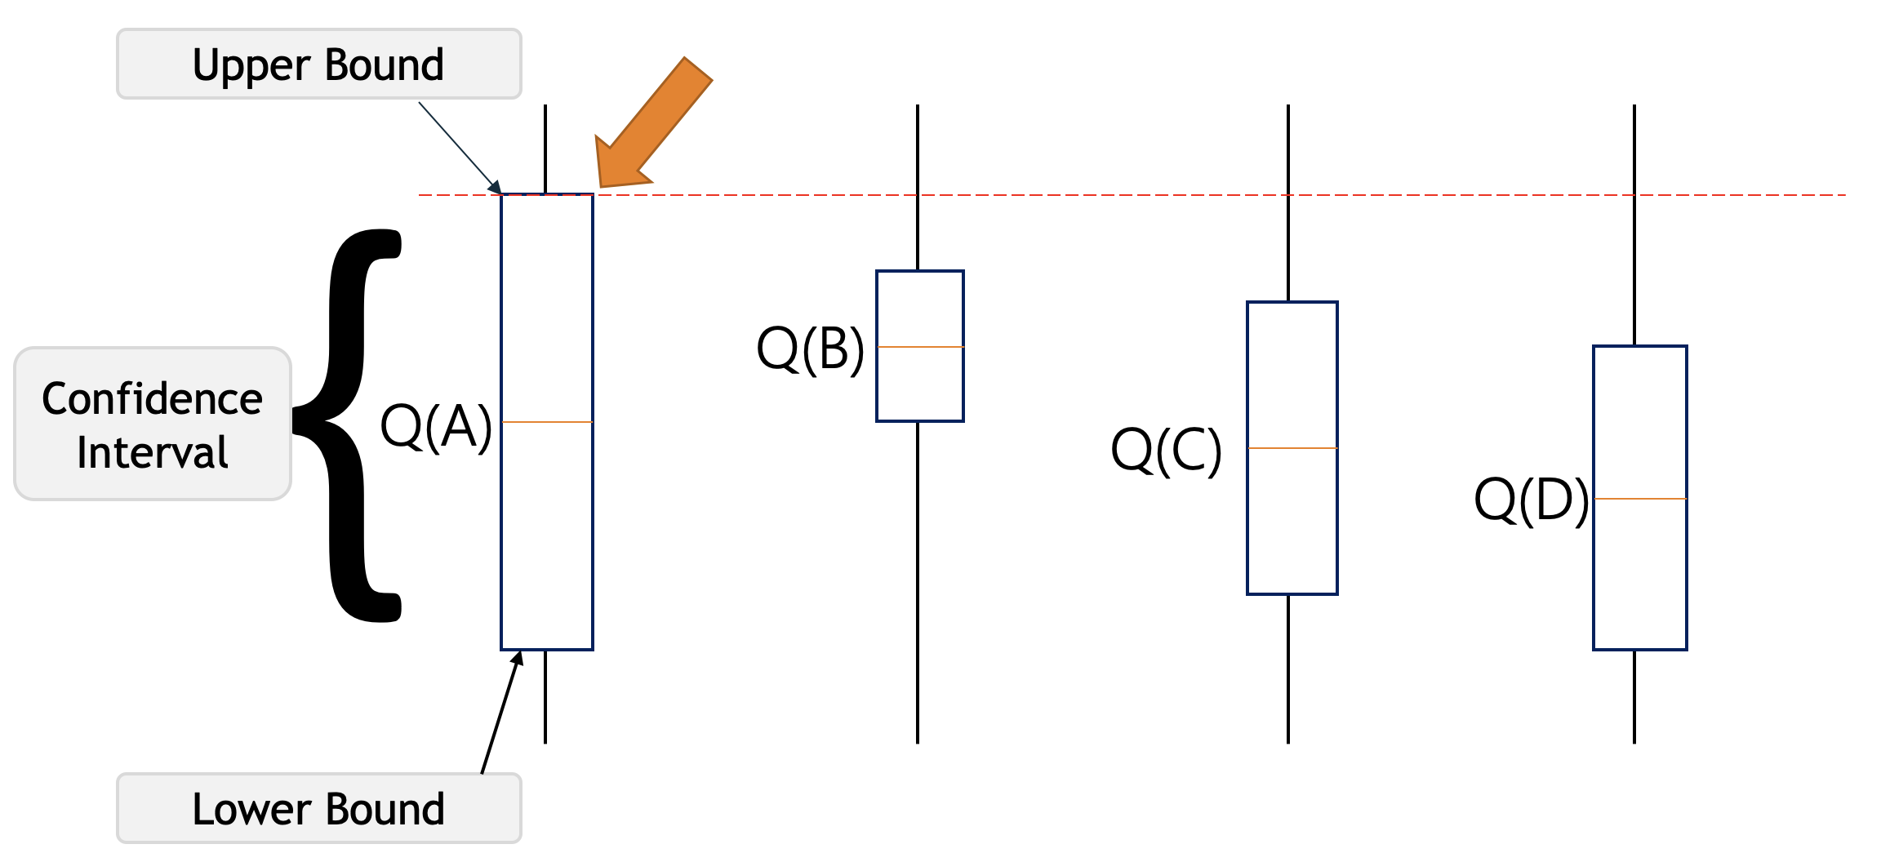
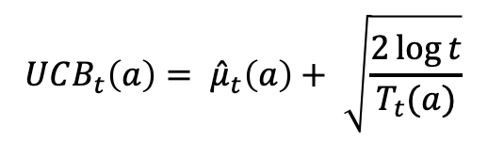
Upper Confidence Bound (UCB) algorithm
$${UCB_{t}\left(a\right)= \hat{μ}}_{t}\left(a\right)+ \sqrt{\frac{2\log{t}}{T_{t}(a)}}$$
https://www.geeksforgeeks.org/upper-confidence-bound-algorithm-in-reinforcement-learning/

Slide 16
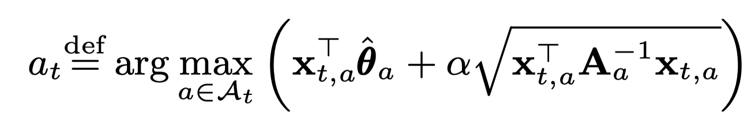
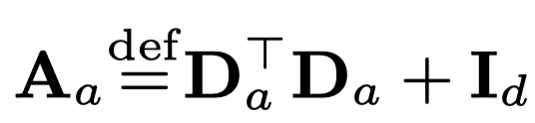
Linear UCB
Linear (ridge) regression + UCB
*this plot is generated with GPUCB, put here as illustration of idea

Slide 17
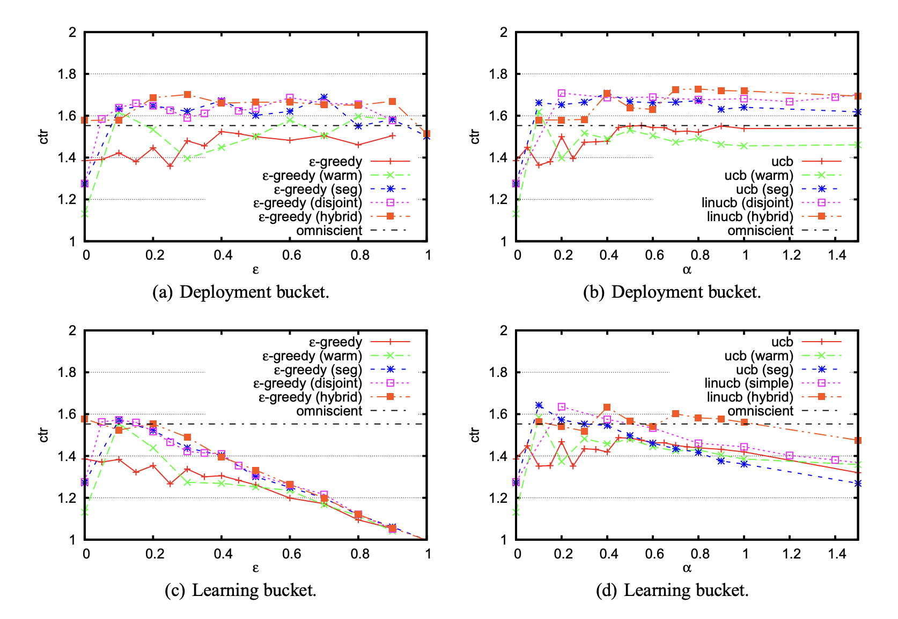
Applications: Recommendation System
Regret minimization: recommend items sequentially to users with the goal of minimize cumulative regret
Arm: item (e.g. news)
Reward: click/ preference
https://arxiv.org/pdf/1003.0146.pdf

Slide 18
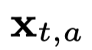
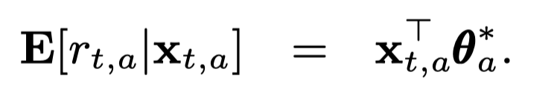
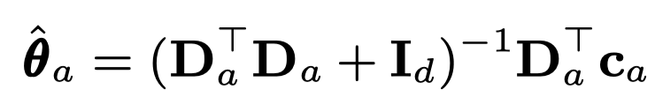
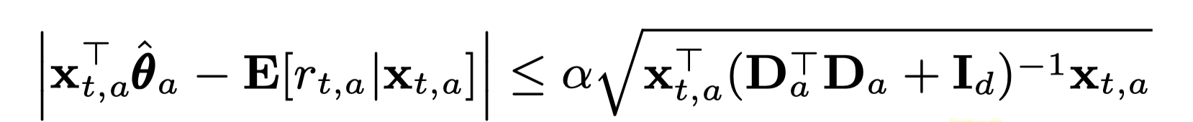
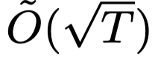
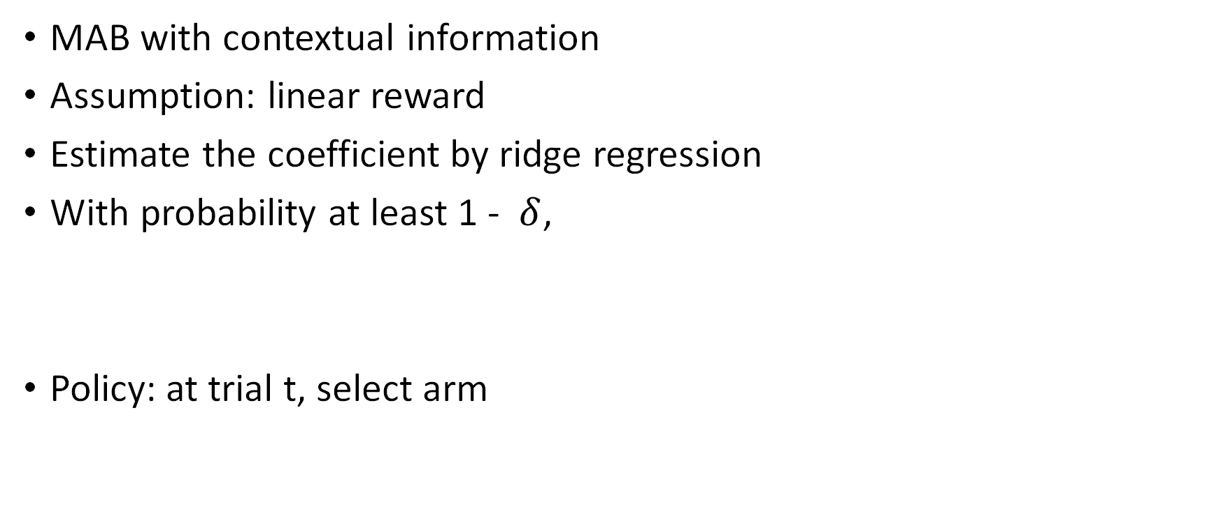
Contextual Bandits - LinUCB
MAB with contextual information
Assumption: linear reward
Estimate the coefficient by ridge regression
With probability at least 1 - $δ$,
Policy: at trial t, select arm

Slide 19
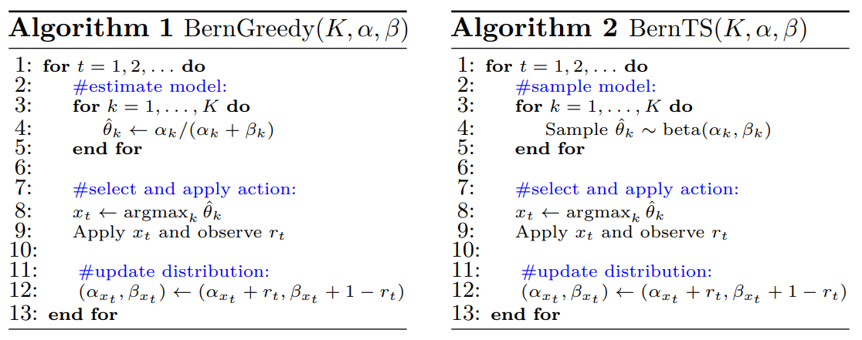
Thompson Sampling for Bernoulli Bandits
- K-armed Bernoulli bandits: the reward of arm $k$ is sampled from a Bernoulli distribution with mean $θ_{k}^{∗}$
- Model the mean reward of each arm as a Beta distribution (conjugated)

Slide 20
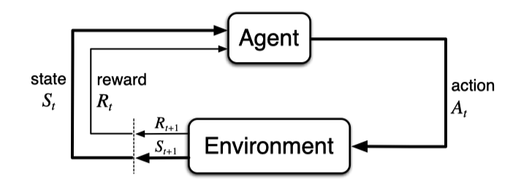
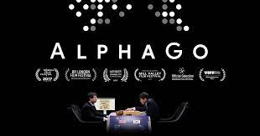
Extension: Reinforcement learning
What if previous recommendation will influence the rewards/choices future recommendations?
E.g. in clinical treatment, the medicine took this month will influence the recommendation of next month – the reward distribution can change!

Slide 21
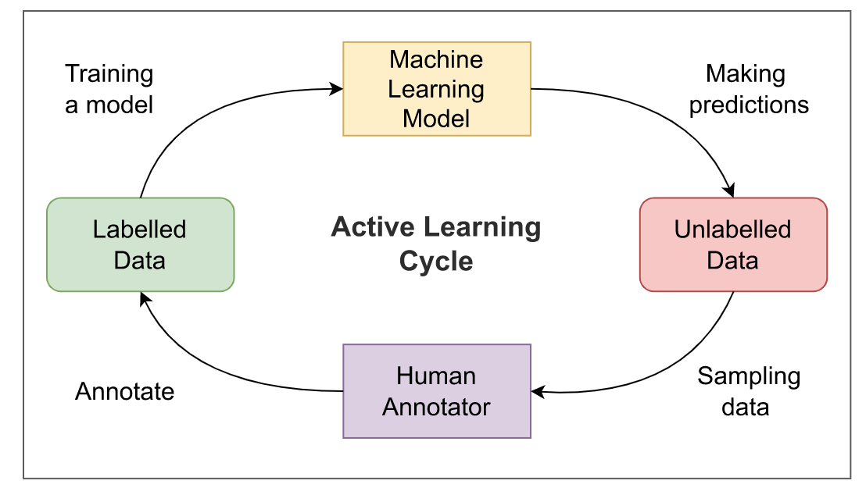
Sequential decision-making: Active Learning
Picture from https://encord.com/blog/an-introduction-to-active-learning-in-machine-learning/

Slide 22
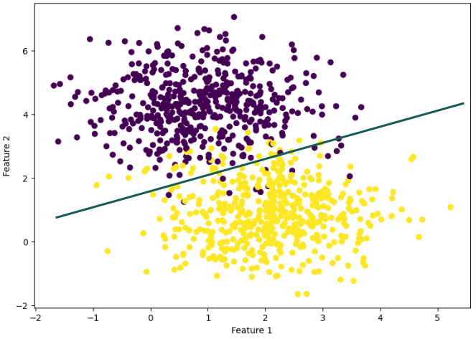
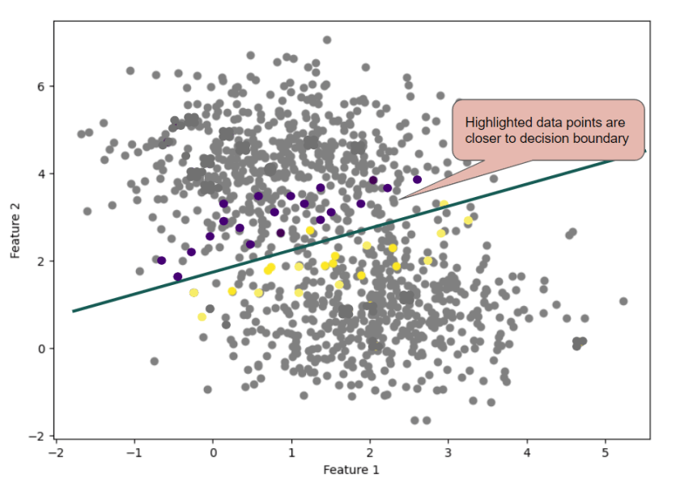
Why active learning
not all data points are equally important for training a model
https://neptune.ai/blog/active-learning-strategies-tools-use-cases

Slide 23
Query Strategies
Uncertainty Sampling
Expected Model Change
Bayesian Active Learning by Disagreement
…

Slide 24
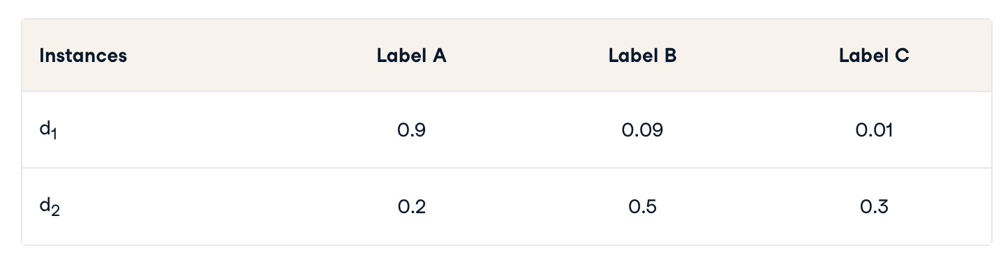
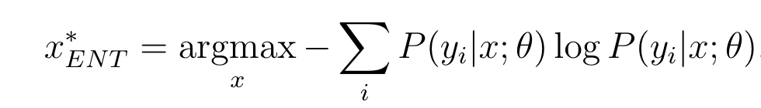
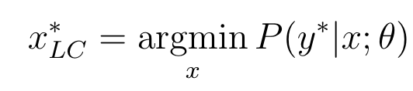
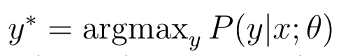
Uncertainty Sampling
Entropy: information-theoretic measure that represents the amount of information needed to “encode” a distribution
Least confident: selects the instance for which it has the least confidence in its most likely label.
Entropy of d1: 0.155
Entropy of d2: 0.447
Select d2
d1 mostly likely label – A with 0.9
d2 mostly likely label – B with 0.5
Select d2
is the most likely class labeling

Slide 25
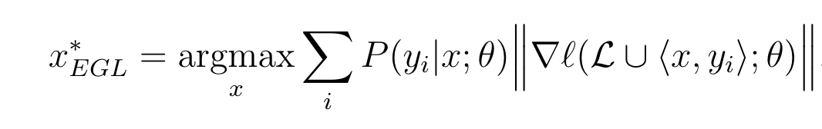
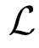
Expected Model Change
the “change” imparted to the model can be measured by the length of the training gradient
the new gradient that would be obtained
by adding the training tuple <x,y> to the training set

Slide 26
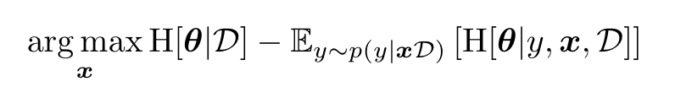
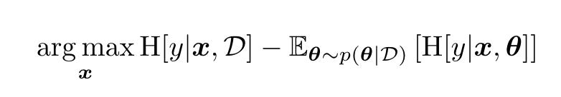
Bayesian Active Learning by Disagreement (BALD)
seek the data point x that maximises the decrease in expected posterior entropy:
seek the x for which the model is marginally most uncertain about y (high H[y|x, D]), but for which individual settings of the parameters are confident (low Eθ∼p(θ|D) [H[y|x, θ]]).

Slide 27
Evaluations
Accuracy improvement: Measure the improvement in classification accuracy or any relevant performance metric compared to a baseline model.
Query efficiency: Evaluate the number of queries or annotations required by the active learning algorithm to achieve a certain performance level.
Learning curve analysis: Plot learning curves to visualize the model's performance with different amounts of labeled data

Slide 28
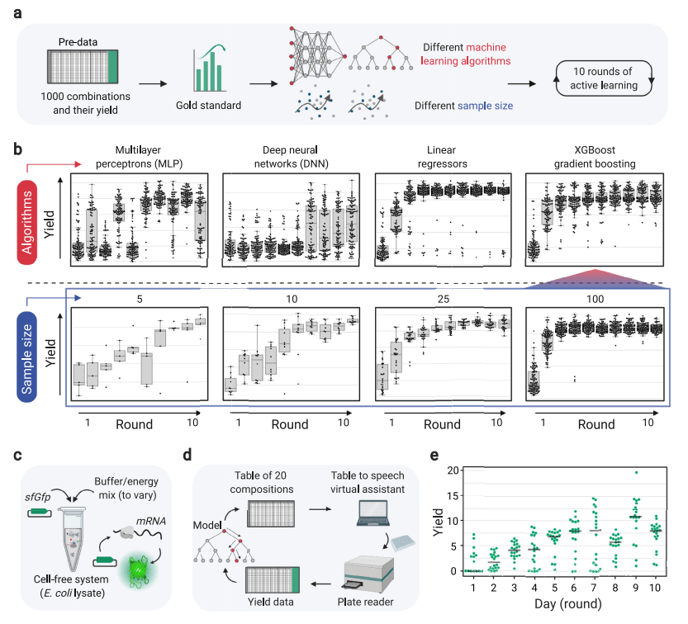
Active learning applications: medical
a maximizing biological objective function (an output/target that depends on multiple factors) with minimal datasets
https://www.nature.com/articles/s41467-022-31245-z.pdf

Slide 29

Active learning application in NLP
improving a Named Entity Recognition (NER) model using active learning
all of the active learning strategies are outperforming the random sampling (RAND) baseline
https://arxiv.org/pdf/1707.05928.pdf

Slide 30

Summary

